Slide 1
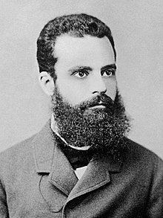
Pareto’s 80/20 Rule (cont.) (1906)
https://youtu.be/JhAqpRUVtzc
https://youtu.be/EAynHZE-lK4
https://youtu.be/iDbdXTMnOmE

Slide 2
The Time Management Mindset
Problem
Inefficiencies
Planning
Critical Thinking
Scheduling
Execution
Analyze
Categorize
Prioritize
Graphic

Slide 3
Graphic
Bar Graph
Project Activity 2
Position
Project Activity 1
Description
Project Activity 3

