Slide 1
Operational Elements of Statistics

Slide 2
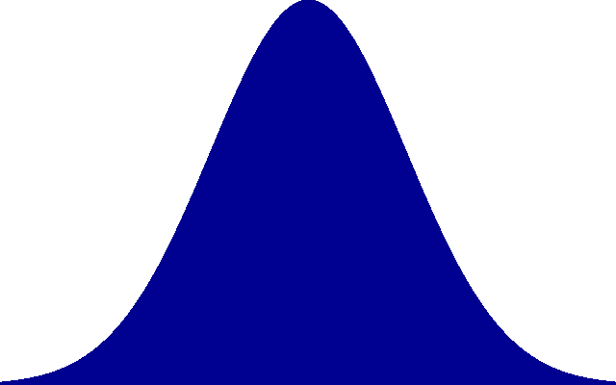
MODULE 5: Statitical Thinking
This Photo by Unknown Author is licensed under CC BY-SA

Slide 3
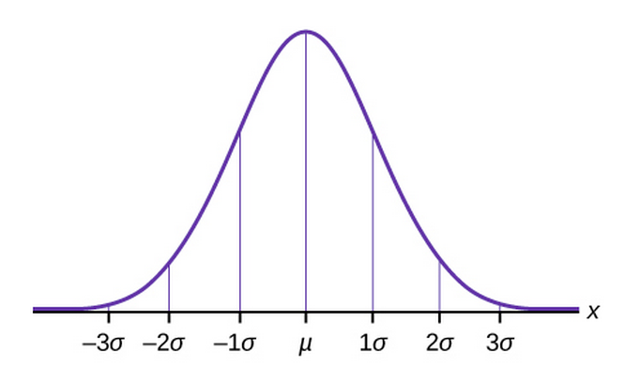
Depiction of a Data Set
67
67
95
95
99
99
This Photo by Unknown Author is licensed under CC BY

Slide 4
Lowest Score
Mean
Higets Score
This Photo by Unknown Author is licensed under CC BY-SA

Slide 5
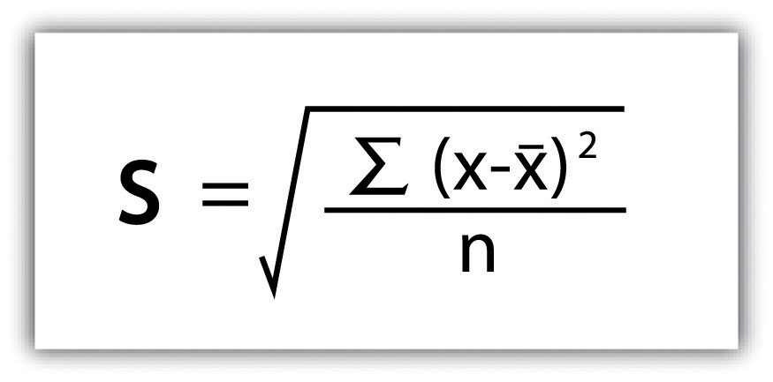
Operational Elements of Statistics
 | Fill In the Table
1
1
1-10 Higher scores Indicate higher Value
This Photo by Unknown Author is licensed under CC BY-SA-NC
Notes:
Pg. 38

Slide 6
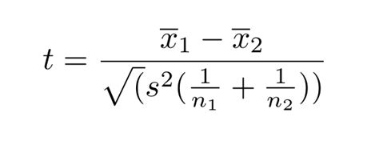
Operational Elements of Statistics
1
2
3
4
5
3
Fill in the Table
2
1
5
4
Notes:
Pg. 38

Slide 7
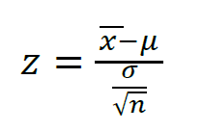
Operational Elements of Statistics
1
2
3
4
5
3
Fill in the Table
2
1
5
4
Notes:
Pg. 38

Slide 8
Operational Elements of Statistics
1
2
3
4
5
3
Fill in the Table
2
1
Y = bX = a
4
Notes:
Pg. 38

Slide 9
Operational Elements of Statistics
2
3
1
2
3
4
5
Fill in the Table
1
4
5
Notes:
Pg. 38

