Slide 1
Evolution of Time
Dr. David (Mac) McCullin
As a Universal Unit of Measure

Slide 2
Evolution of Time
Dr. David (Mac) McCullin
Citation
McCullin, David E, 2021,Evolution of Time presentation

Slide 3




What Time Measures

Slide 4
What Does Time Measure

Slide 5
What Time Measures

Slide 6
What Time Measures

Slide 7
What Time Measures

Slide 8
What Time Measures

Slide 9
What Time Measures

Slide 10
What Time Measures

Slide 11
What Time Measures

Slide 12
What Time Measures

Slide 13








Life Cycles

Slide 14
Clues of Time

Slide 15
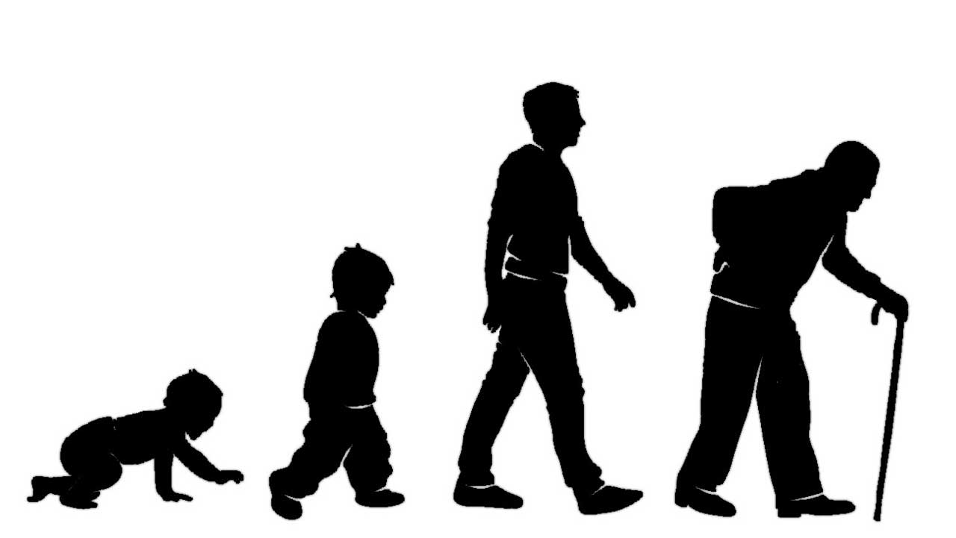

Life Cycles

Slide 16



Life Cycles

Slide 17



Evolution of Measuring Time

Slide 18



Evolution of Time Precision

Slide 19

Minutes Hours Work-Days

Slide 20
Minutes Hours Work-Days

Slide 21
Minutes Hours Work-Days

Slide 22
Minutes Hours Work-Days

Slide 23

















Minutes Hours Work-Days

Slide 24
8 Hour Work-Day

Slide 25
8 Hour Work-Day

Slide 26
8 Hour Work-Day X 5 = 40 Hour Work -Week

Slide 27

Trafficking of Time

Slide 28
Trafficking of Time
Time Management
Strategic Planning

Slide 29
Trafficking of Time
Work Life Balance

Slide 30
Trafficking of Time
Leisure
Non work Activities

